Slide 1
Week 4: Market Analysis
HPM 6503
Spring 2026
Nada Boualam, PhD

Slide 2
Announcements
Grading policy change
  Only your top two exam grades will be weighted, and will make up 75% of your grade
Exam 1 will be 6pm-8:20pm next week in this room
I will hold a review session on Zoom on Monday 02/16 6-7:30pm
Problem Set 2 will be assigned after class today
  Due 03/25
  We will review PS2 during the review session on Monday
Changes we are implementing to class thanks to your feedback:
  ~Half of class will be problem-set based
  ~Half of class will be lectures
  I will hold an office hour every Friday 9-10am starting 2/20
  Please do email me to set up separate office hours should you need them

Slide 3
Today’s Outline
HW 1 Review
Last Class Review & Example Problems
Market Analysis

Slide 4
HW 1 Review
Notes:
When patients choose to attend the vaccination clinic, they are giving up other
activities they could be doing during that time, such as working, studying, or engaging in leisure
activities. The time spent waiting for the vaccinations has value, and this represents an
opportunity cost. Even though the vaccinations themselves do not have a monetary cost, the time
and resources spent to acquire them come at a cost: the loss of alternative activities.

Slide 5
HW 1 Review
1. A health center in your neighborhood is distributing flyers announcing that it will be offering a free vaccination clinic for Covid, flu, and RSV shots. The flyer warns that the clinic anticipates high patient volume so patients should anticipate substantial wait times. Using terms discussed in class, explain why an economist would say that these vaccinations are not really “free” to patients.
Notes:
When patients choose to attend the vaccination clinic, they are giving up other
activities they could be doing during that time, such as working, studying, or engaging in leisure
activities. The time spent waiting for the vaccinations has value, and this represents an
opportunity cost. Even though the vaccinations themselves do not have a monetary cost, the time
and resources spent to acquire them come at a cost: the loss of alternative activities.

Slide 6
HW 1 Review
2. Suppose you’ve already studied for four hours for tomorrow’s exam. You’re debating whether to study for one more hour or to go to sleep earlier. What should you compare to make that decision at the margin?
Notes:
When patients choose to attend the vaccination clinic, they are giving up other
activities they could be doing during that time, such as working, studying, or engaging in leisure
activities. The time spent waiting for the vaccinations has value, and this represents an
opportunity cost. Even though the vaccinations themselves do not have a monetary cost, the time
and resources spent to acquire them come at a cost: the loss of alternative activities.

Slide 7
HW 1 Review
3) What are the eight factors that differentiate health economics from economics? In your own words, elaborate on 2 of them.
Notes:
When patients choose to attend the vaccination clinic, they are giving up other
activities they could be doing during that time, such as working, studying, or engaging in leisure
activities. The time spent waiting for the vaccinations has value, and this represents an
opportunity cost. Even though the vaccinations themselves do not have a monetary cost, the time
and resources spent to acquire them come at a cost: the loss of alternative activities.

Slide 9
Last Class Review
Isocost & Isoquant Curves
Supply Curve & Marginal Cost
Cost Structures
Marginal Productivity

Slide 10
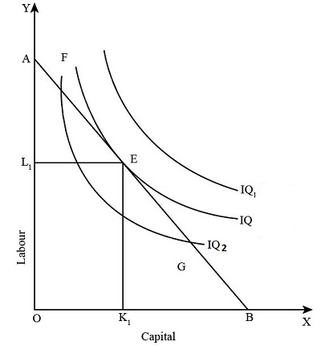
Last Class Review
Isocost & Isoquant Curves

Slide 11
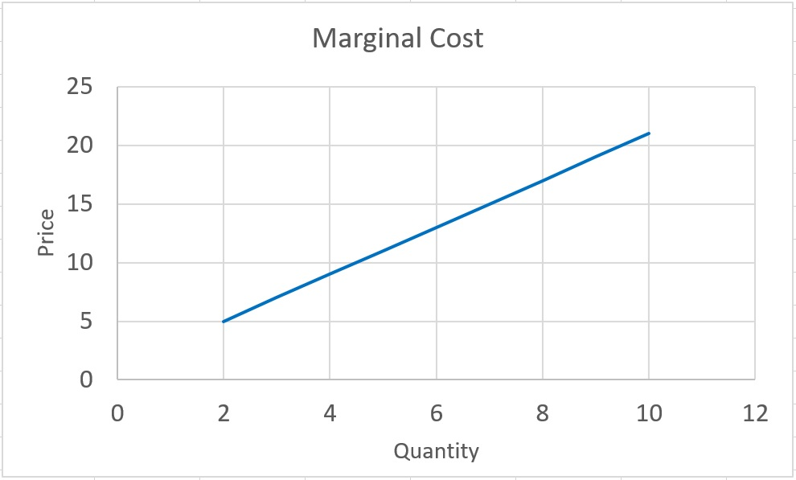
Last Class Review
Supply Curve: Marginal Cost Curve
Notes:
Law of supply, there is a positive relationship between the price of a good or service and the amount of it that suppliers are willing to produce
So, the supply curve is a relationship that tells us the minimum amount that a firm is willing to accept for selling a unit of a good. What is this minimum amount? Well, if you are a firm, and you need to make one more unit of a good, then the cost to you of that good is the marginal cost of that good. To make the good, you need to recover, at a minimum, your marginal cost. Therefore, the supply curve IS the marginal cost curve.
So, in order to find the supply curve (function), we need to extract the marginal cost from the total cost function. This graph tells us if the price is $15, this producer is willing to produce 7 unites of the good. Or, for example, the minimum amount of money that this producer is willing to exchange for producing 4 units, is $9.

Slide 12

Last Class Review
Cost Structures
  Fixed Costs
  Variable Costs
  Total Costs
Marginal Costs
  $M⁢C={\left(Δ T⁢C\right)}/{\left(Δ Q\right)} = {\left(T⁢C_{2} – T⁢C_{1}\right)}/{\left(Q_{2}−Q_{1}\right)}$
  MC = Supply Curve

Slide 13
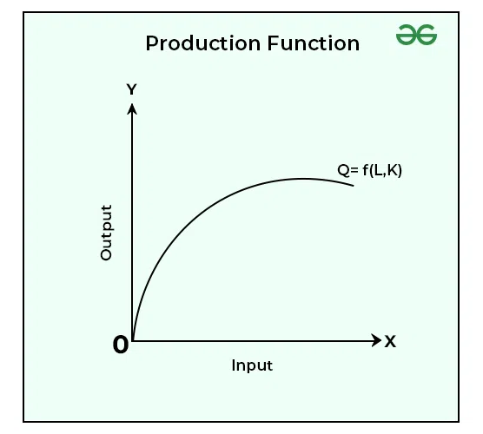

Last Class Review
Marginal Productivity → What creates costs?
Production function $Y=f(K,L)$

Slide 14
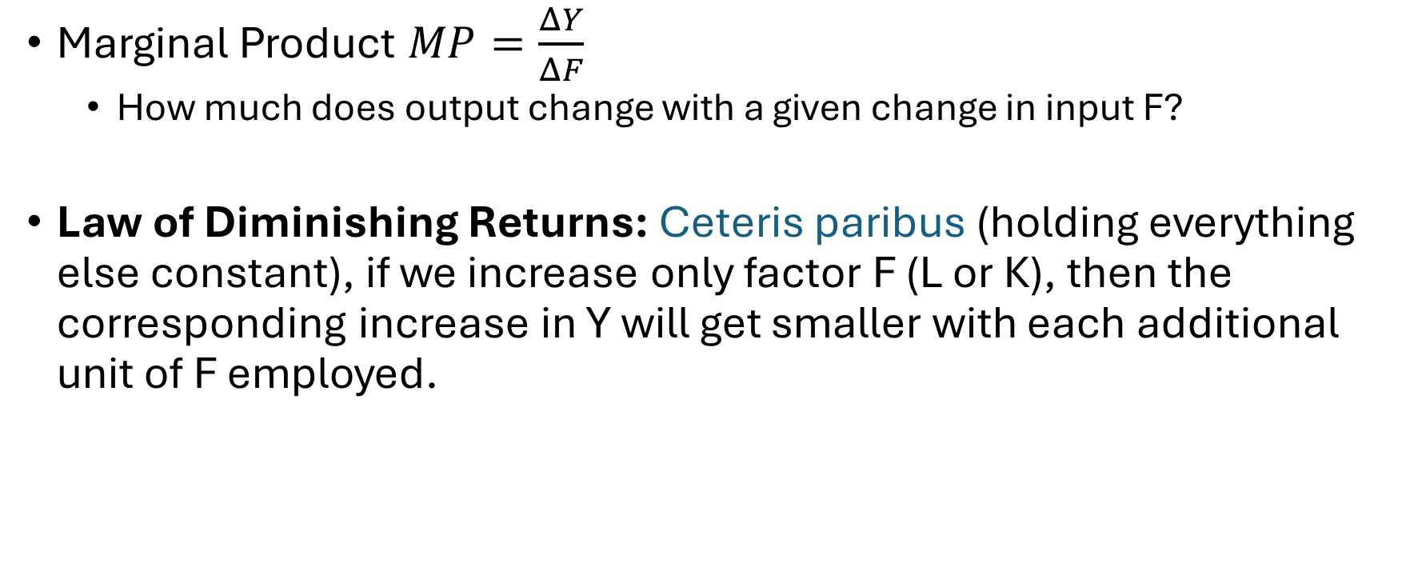
Last Class Review
Marginal Product $MP=\frac{ΔY}{ΔF}$
  How much does output change with a given change in input F?
Law of Diminishing Returns: Ceteris paribus (holding everything else constant), if we increase only factor F (L or K), then the corresponding increase in Y will get smaller with each additional unit of F employed.

Slide 15
Example problems
Get into groups of 4-5

Slide 16
Example problems
Assume the price of blueberries is 6 and the price of labor is 100. Fill in the table. Here, profits = total revenue minus total labor costs. What is the profit-maximizing amount of labor to hire?

Slide 17
Example problem 1

Slide 18
Example problem 1
# of Workers | Total Output, pounds | Total revenue (P x Q), dollars | Marginal revenue, dollars | Total labor costs, dollars | Marginal labor cost, dollars | Profits
0 | 0 | 0 | NA | NA | NA | 0
1 | 70 | 420 | 420 | 100 | 100 | 320
2 | 130 | 780 | 360 | 200 | 100 | 580
3 | 180 | 1080 | 300 | 300 | 100 | 780
4 | 220 | 1320 | 240 | 400 | 100 | 920
5 | 250 | 1500 | 180 | 500 | 100 | 1000
6 | 260 | 1560 | 60 | 600 | 100 | 960

Slide 19

One step further
We compare the marginal revenue from labor to the marginal cost of labor to answer the question:
"How much more money do we make from investing in another unit of some factor of production?”
To maximize profits, we want the marginal revenue (MR) from employing an extra unit of factor to be greater than the marginal cost (MC)
$$\frac{MR}{MC}>1$$

Slide 20
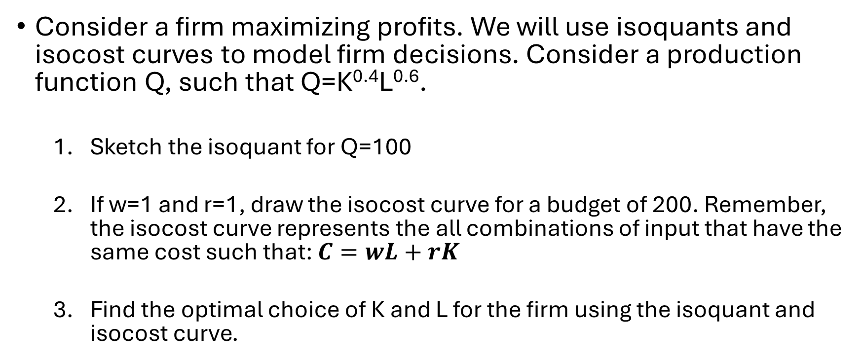
Example Problem 2
Consider a firm maximizing profits. We will use isoquants and isocost curves to model firm decisions. Consider a production function Q, such that Q=K^{0.4}L^{0.6}.
  Sketch the isoquant for Q=100
  If w=1 and r=1, draw the isocost curve for a budget of 200. Remember, the isocost curve represents the all combinations of input that have the same cost such that: $C=wL+rK$
  Find the optimal choice of K and L for the firm using the isoquant and isocost curve.

Slide 21
Example Problem 2
Isoquant for Q=100 (blue line)
K L Q
25 400 100
50 200 100
100 100 100
200 50 100
400 25 100
IC curve for r=1, w=1 (orange line)
K L B
200 0 200
150 50 200
100 100 200
50 150 200
0 200 200

Slide 22
Example problem 3
An urgent care clinic employs an ER physician who works a 10-hour shift and uses an MRI machine purchased for $50,000. The ER physician can treat 20 patients per shift and earns $100 per hour. The ER physician exhibits diminishing marginal productivity throughout the course of her shift. For simplicity, assume that all patients are identical.

Slide 23
Example Problem 3
What is the average product for this doctor?
What is the average variable cost of ER physician visit per patient?
What is the average total cost of the ER physician visit per patient?
Based only on the information above, it can be assumed that the ER doctor will spend more than _______ minutes treating their final patient of the day.

Slide 24
Example Problem 3
What is the average product for this doctor?
AP = Q/L
Q= 20 patients, L = 10 hours → AP = 20/10 = 2
This doctor can see 2 patients per hour.

Slide 25
Example Problem 3
2. What is the average variable cost of the ER physician per patient?
AVC per patient = wage per hour / patients per hour = 100/2 = $50
AVC per patient = total wage / total patients = 100*10/20 = $50

Slide 26
Example Problem 3
3. What is the average total cost of the ER physician per patient?
ATC per patient = (total wage + fixed cost) / total patients
ATC per patient = (50,000+100*10)/20 = $2,550 per patient

Slide 27
Example Problem 3
4. Based only on the information above, it can be assumed that the ER doctor will spend more than _______ minutes treating their final patient of the day.
Average time per patient = 10 hours / 20 patients = 30 min / patient
Due to diminishing marginal returns, the marginal product should exceed the average time.

Slide 28
Example Problem 3
4. Based only on the information above, it can be assumed that the ER doctor will spend more than _______ minutes treating their final patient of the day.
Average time per patient = 10 hours / 20 patients = 30 min / patient
Due to diminishing marginal returns, the marginal product should exceed the average time.

Slide 29
Break, Questions

Slide 30

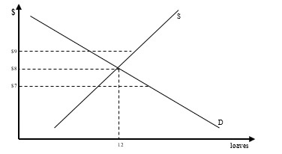
Market Analysis
So far, we’ve seen
  Demand
  Supply
Today’s Focus: Equilibrium
Physician services
Notes:
eq: 12 loaves at $8
- at $7 supply falls short of demand (shortage)
- at $9 supply outpaces demand (surplus)
Everybody is a price taker.

Slide 31
Comparative Statics
What happens to the equilibrium if something outside of the model changes?
Notes:
“Comparative statics is about asking: if something outside the model changes, what happens to the equilibrium? We treat that change as exogenous, then compare the original equilibrium to the new one. In other words, we’re using the model to trace how a parameter shift—like a tax, a technology shock, or a preference change—feeds through to prices and quantities. That before‑and‑after comparison is the core of what we do in economic analysis.”
French report (good news about French wine, say quality or health benefits): that’s a positive demand shock. The demand curve shifts right, so the new equilibrium has a higher price and a higher quantity bought and sold.

Slide 32
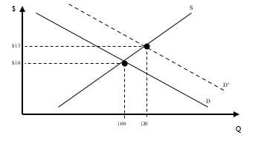
Comparative Statics – French report example
Old equilibrium
New equilibrium
Notes:
“Comparative statics is about asking: if something outside the model changes, what happens to the equilibrium? We treat that change as exogenous, then compare the original equilibrium to the new one. In other words, we’re using the model to trace how a parameter shift—like a tax, a technology shock, or a preference change—feeds through to prices and quantities. That before‑and‑after comparison is the core of what we do in economic analysis.”
French report (good news about French wine, say quality or health benefits): that’s a positive demand shock. The demand curve shifts right, so the new equilibrium has a higher price and a higher quantity bought and sold.

Slide 33
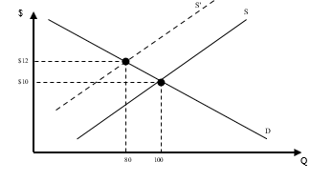
Comparative Statics – El Niño example
New equilibrium
Old equilibrium
Notes:
El Niño (bad weather hitting vineyards): that’s a negative supply shock. The supply curve shifts left, so the new equilibrium has a higher price but a lower quantity bought and sold.

Slide 34
Price conveys information
So far, we assume everyone is a price taker
Why price goes up may not always be clear
But the fact that price went up → something changed
Notes:
And that something can be exogenous like the examples we talked about to
… or we could be dealing with different market structures

Slide 35
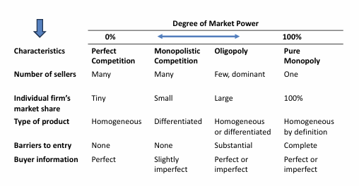
Market Structures

Slide 36
Market Power
Definition
Market Power: The ability of a seller/supplier to influence price, rather than just accept market prices.
  Ability of a firm to restrict output and restrict output to raise prices
Notes:
Someone a few weeks ago asked about diamond scarcity & pricing
→ Diamond supply low → high price

Slide 37
Perfectly Competitive Market
Buyers and sellers
Price takers – market sets the price/sellers face perfectly elastic demand curve
Buyers – maximize utility
Buy up to the point where marginal private benefit, MPB – represented by their demand curve -- equals market price
Firms – maximize profit
Produce and sell – up to the point where market price equals marginal private cost, MPC represented by their supply curve

Slide 38
Perfectly Competitive Market
Definition
Private Cost: cost borne directly by the individual consumer or firm involved in the transaction.
Definition
Social Cost: cost to all in society, including those who do not consume the good in question.
Social Cost = Private cost + External Cost

Slide 39

Perfectly Competitive Market
Perfectly competitive market clears at the level of output where marginal private benefit to buyers equal the marginal private costs to producers
Equilibrium is where the demand curve intersects with the supply curve
$$MPB=MPC$$

Slide 40
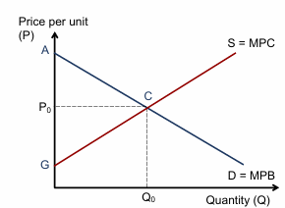

Perfectly Competitive Market
$$MPB=MPC$$

Slide 41
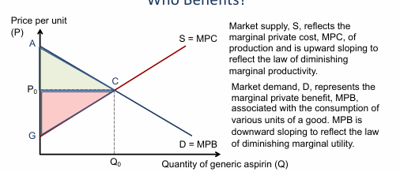
Perfectly Competitive Market
Consumer Surplus
Provider Surplus

Slide 42
Who benefits in a perfectly competitive market?
Definition
Consumer Surplus: Net benefit to consumers from engaging in free exchange.
  Difference between what the consumer would be willing to pay and what the consumer actually has to pay
  Area under the demand curve but above price
Definition
Producer Surplus: Net benefit to producers from participating in free trade
  Difference between the actual revenue received by the seller and the amount needed to cover the marginal costs of production
  Area below market price but above the supply curve
Total societal surplus (net gains from trade) = consumer + producer surplus

Slide 43
Who benefits in a perfectly competitive market?
At equilibrium, total societal surplus is maximized
  Efficient outcome
  Demand is determined by value of good and ability to pay
What does this say about equity? Nothing

Slide 44
Who benefits in a perfectly competitive market?
At equilibrium, total societal surplus is maximized
  Efficient outcome
  Demand is determined by value of good and ability to pay
What does this say about equity? Nothing

Slide 45


Slide 46
Government interventions in free market
How many of you live in rent-controlled apartments?
  Rent control is a government intervention setting a price ceiling
Notes:
These policies have good intentions, but they create winners and losers. Winners: those who get rent control apt. Have you ever been in one? Losers: landlords, grocery store owners in Mugabe, etc. Diminishes their incentive to supply the good. But also consumers who couldn’t get one at equilibrium price even though they were prepared to pay for it. Examples of very wealthy people with summer homes in the hamptons and a barely used rent controlled apt. Why not keep it?
Other examples:
Mugabe (Zimbabwe): puts a price ceiling on food in place so everyone can “afford” food.
-draw shortage
Hurricane Sandy: price cap on gas stations – can’t raise price after hurricanes. Another shortage: gas stations ran out of gas when we needed it the most.
Food subsidies – gov’t subsidizes production of corn through price floor [draw].Guarantees farmer price above floor, but consumer only pays floor. Costs HHs $390/yr, gives farmers $19k/yr. Vast majority goes to large farms, not family farms. Also for wheat, rice and cotton. Why twinkies are cheaper than carrots – already paid for it through taxes before you bought it. Economists disagree on a lot (health care reform, taxes), but not on this. Plus, leads to a surplus of one type of food: carbs. Now it is a public health problem.

Slide 47
Government interventions in free market
What happens to the supply and demand graph if the government introduces a price ceiling for rents?
Y = price (rent)
X = number of apartments available for rent in NYC
Notes:
These policies have good intentions, but they create winners and losers. Winners: those who get rent control apt. Have you ever been in one? Losers: landlords, grocery store owners in Mugabe, etc. Diminishes their incentive to supply the good. But also consumers who couldn’t get one at equilibrium price even though they were prepared to pay for it. Examples of very wealthy people with summer homes in the hamptons and a barely used rent controlled apt. Why not keep it?
Other examples:
Mugabe (Zimbabwe): puts a price ceiling on food in place so everyone can “afford” food.
-draw shortage
Hurricane Sandy: price cap on gas stations – can’t raise price after hurricanes. Another shortage: gas stations ran out of gas when we needed it the most.
Food subsidies – gov’t subsidizes production of corn through price floor [draw].Guarantees farmer price above floor, but consumer only pays floor. Costs HHs $390/yr, gives farmers $19k/yr. Vast majority goes to large farms, not family farms. Also for wheat, rice and cotton. Why twinkies are cheaper than carrots – already paid for it through taxes before you bought it. Economists disagree on a lot (health care reform, taxes), but not on this. Plus, leads to a surplus of one type of food: carbs. Now it is a public health problem.

Slide 48
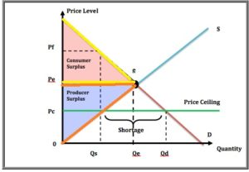
Government interventions in free market
If there is no price ceiling, the market equilibrium will be at (e) and the maximum surplus would be realized
Yellow triangle is the consumer surplus
Orange triangle is the producer
e
Notes:
These policies have good intentions, but they create winners and losers. Winners: those who get rent control apt. Have you ever been in one? Losers: landlords, grocery store owners in Mugabe, etc. Diminishes their incentive to supply the good. But also consumers who couldn’t get one at equilibrium price even though they were prepared to pay for it. Examples of very wealthy people with summer homes in the hamptons and a barely used rent controlled apt. Why not keep it?
Other examples:
Mugabe (Zimbabwe): puts a price ceiling on food in place so everyone can “afford” food.
-draw shortage
Hurricane Sandy: price cap on gas stations – can’t raise price after hurricanes. Another shortage: gas stations ran out of gas when we needed it the most.
Food subsidies – gov’t subsidizes production of corn through price floor [draw].Guarantees farmer price above floor, but consumer only pays floor. Costs HHs $390/yr, gives farmers $19k/yr. Vast majority goes to large farms, not family farms. Also for wheat, rice and cotton. Why twinkies are cheaper than carrots – already paid for it through taxes before you bought it. Economists disagree on a lot (health care reform, taxes), but not on this. Plus, leads to a surplus of one type of food: carbs. Now it is a public health problem.

Slide 49
Government interventions in free market
If a binding price ceiling is set, then:
Qd > Qs
→ Shortage of apartments
e
Notes:
These policies have good intentions, but they create winners and losers. Winners: those who get rent control apt. Have you ever been in one? Losers: landlords, grocery store owners in Mugabe, etc. Diminishes their incentive to supply the good. But also consumers who couldn’t get one at equilibrium price even though they were prepared to pay for it. Examples of very wealthy people with summer homes in the hamptons and a barely used rent controlled apt. Why not keep it?
Other examples:
Mugabe (Zimbabwe): puts a price ceiling on food in place so everyone can “afford” food.
-draw shortage
Hurricane Sandy: price cap on gas stations – can’t raise price after hurricanes. Another shortage: gas stations ran out of gas when we needed it the most.
Food subsidies – gov’t subsidizes production of corn through price floor [draw].Guarantees farmer price above floor, but consumer only pays floor. Costs HHs $390/yr, gives farmers $19k/yr. Vast majority goes to large farms, not family farms. Also for wheat, rice and cotton. Why twinkies are cheaper than carrots – already paid for it through taxes before you bought it. Economists disagree on a lot (health care reform, taxes), but not on this. Plus, leads to a surplus of one type of food: carbs. Now it is a public health problem.

Slide 50
Government interventions in free market
CS
Deadweight Loss
Definition
Deadweight Loss: loss of total that occurs when a market is prevented from reaching the efficient equilibrium quantity
e
PS
Notes:
These policies have good intentions, but they create winners and losers. Winners: those who get rent control apt. Have you ever been in one? Losers: landlords, grocery store owners in Mugabe, etc. Diminishes their incentive to supply the good. But also consumers who couldn’t get one at equilibrium price even though they were prepared to pay for it. Examples of very wealthy people with summer homes in the hamptons and a barely used rent controlled apt. Why not keep it?
Other examples:
Mugabe (Zimbabwe): puts a price ceiling on food in place so everyone can “afford” food.
-draw shortage
Hurricane Sandy: price cap on gas stations – can’t raise price after hurricanes. Another shortage: gas stations ran out of gas when we needed it the most.
Food subsidies – gov’t subsidizes production of corn through price floor [draw].Guarantees farmer price above floor, but consumer only pays floor. Costs HHs $390/yr, gives farmers $19k/yr. Vast majority goes to large farms, not family farms. Also for wheat, rice and cotton. Why twinkies are cheaper than carrots – already paid for it through taxes before you bought it. Economists disagree on a lot (health care reform, taxes), but not on this. Plus, leads to a surplus of one type of food: carbs. Now it is a public health problem.

Slide 51
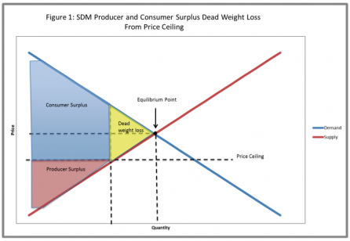
Government interventions in free market
These policies have good intentions, but they create winners and losers.
Notes:
Winners: those who get rent control apt. Have you ever been in one? Losers: landlords, grocery store owners in Mugabe, etc. Diminishes their incentive to supply the good. But also consumers who couldn’t get one at equilibrium price even though they were prepared to pay for it. Examples of very wealthy people with summer homes in the hamptons and a barely used rent controlled apt. Why not keep it?

Slide 52
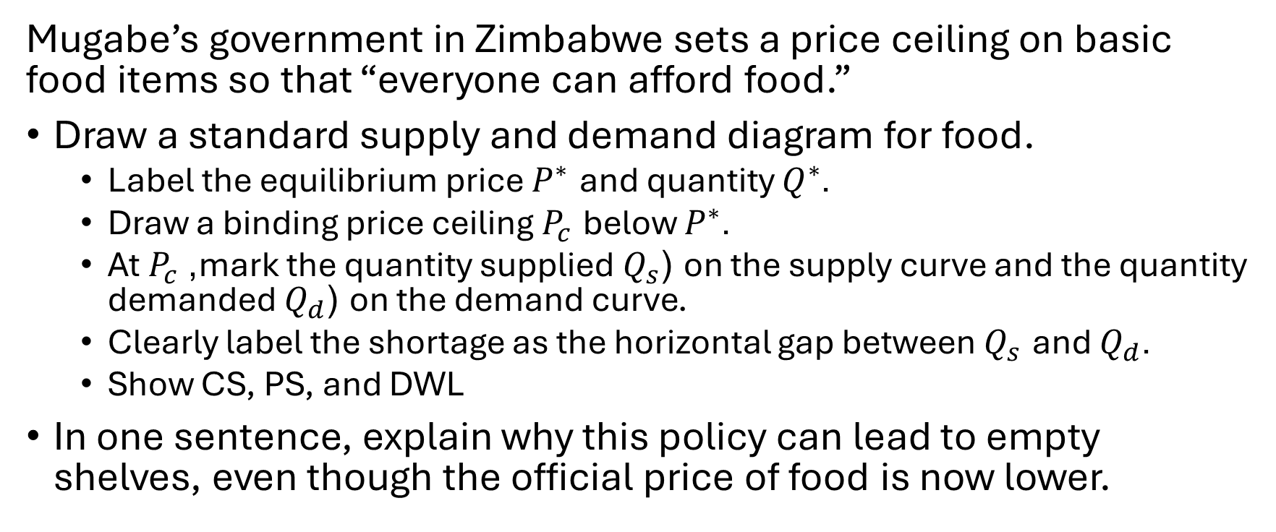
Example Problem
Mugabe’s government in Zimbabwe sets a price ceiling on basic food items so that “everyone can afford food.”
Draw a standard supply and demand diagram for food.
  Label the equilibrium price $P^{∗}$ and quantity $Q^{∗}$.
  Draw a binding price ceiling $P_{c}$ below $P^{∗}$.
  At $P_{c}$, mark the quantity supplied $Q_{s}$ (on the supply curve and the quantity demanded $Q_{d}$ (on the demand curve.
  Clearly label the shortage as the horizontal gap between $Q_{s}$ and $Q_{d}$.
  Show CS, PS, and DWL
In one sentence, explain why this policy can lead to empty shelves, even though the official price of food is now lower.
Notes:
These policies start from good intentions: keep rents affordable, protect farmers’ incomes, stabilize food prices.
But because they control prices directly, they inevitably create winners and losers, and they distort incentives to supply the good.”

